Slide 1

Niklas Winter Data Analytics Portfolio
March 13, 2023

Slide 2
Data Analysis Projects
1. Instacart Grocery Baskets
2. Rockbuster Stealth LLC.
3. GameCo
Consumer behaviour and marketing Analysis with Python
Business analysis of an online video-rental company with SQL
Historic analyse of the video-game industrie with EXCEL

Slide 3






1. Instacart Grocery Basket
Instacart is an American online grocery shop that operates inn the US and Canda!
Objectives | Data | Tools and Skills
Identify the sales trends and customer purchasing behaviours of Instacart to develop new marketing and sales strategies | Open source data by Instacart, available online here: https://s3.amazonaws.com/coach-courses-us/public/courses/data-immersion/A4/A4_Data_Assets/customers.zip | Exploratory data analysis, data wrangling and subletting and data visualization in Python with a final report in excel.

Slide 4
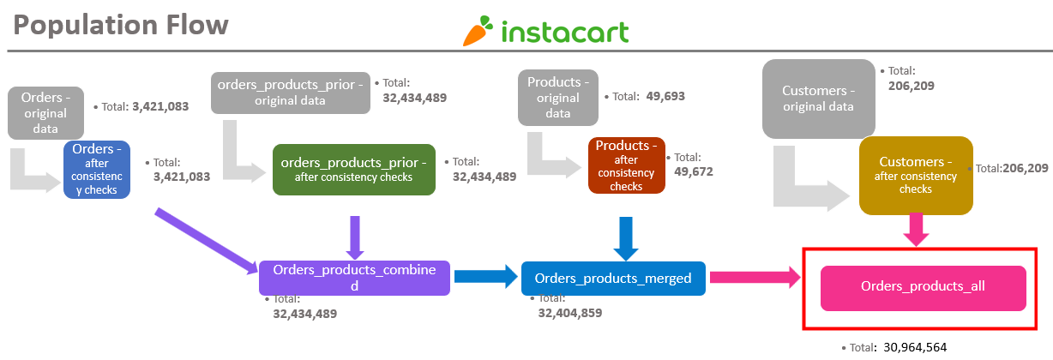
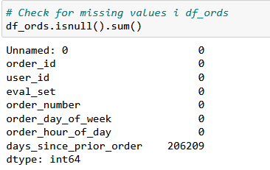
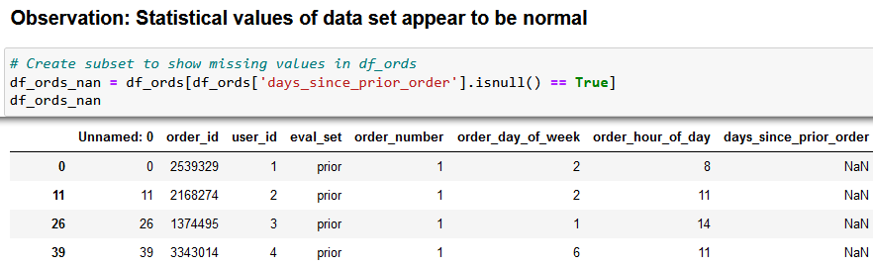
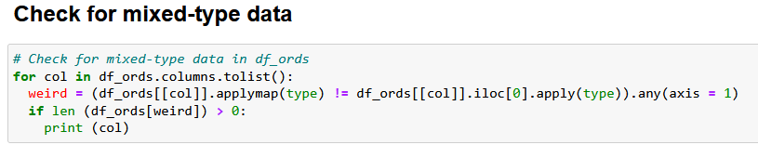
1. Population flow and data cleaning

Slide 5
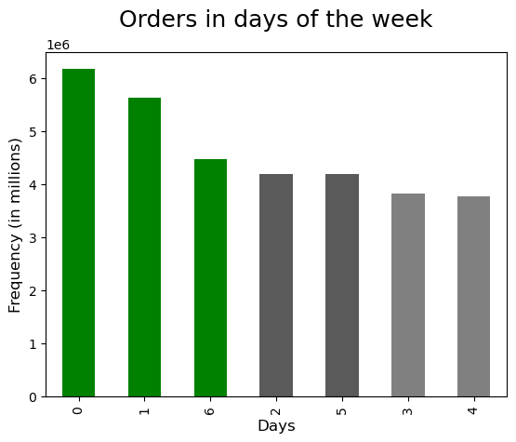
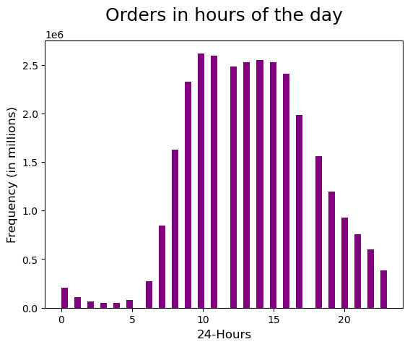
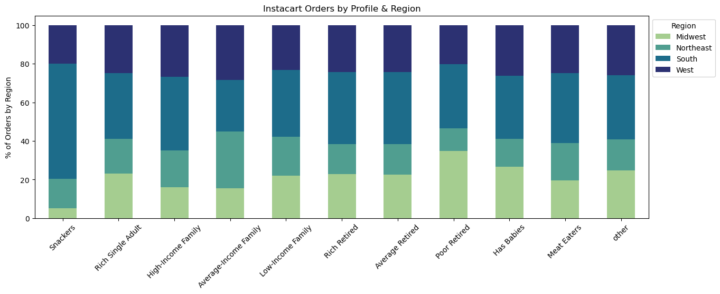
1. Instacart Consumer Behaviour Analysis
Saturday, Sunday and Friday respectively are the busiest days of the week.
In terms of time in a day, between 10am to 3pm is the busiest time to place an order.
Average-retired customers are the most common Instacart users and can be found in the southern regions!

Slide 6
1. Key recommendations for Instacart
Most of the sales are on weekends approximately from 10-16pm. The marketing team can schedule ads outside these period.
Produce, dairy-eggs, beverages and snacks are the most sold items by Instacart. It is recommended to always pay attention to the stock management of these product categories.
Instacart customer base is in the South and West of the country. These two regions also have the highest spending customers. Instacart should focus its efforts on growing in the Midwest and Northeast.

Slide 7


2. Rockbuster LLC.
Rockbuster is a newly establishedd video rental business
Objectives | Data | Tools and Skills
Transitition from the physical movie rental market to an online model. Plan a competitive strategy to face the steep challenges posed by the video streaming platforms. | Relational databases made up of 17 tables which contains information on film rentals, movies, customers, payments… Full Data Set | Relational databases management. Databes querying with SQL: Filtering, Joining Tables, Subqueries & CTE, Visualizations

Slide 8
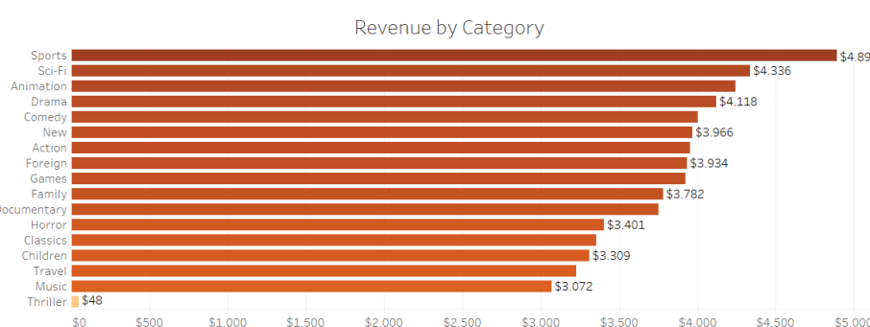
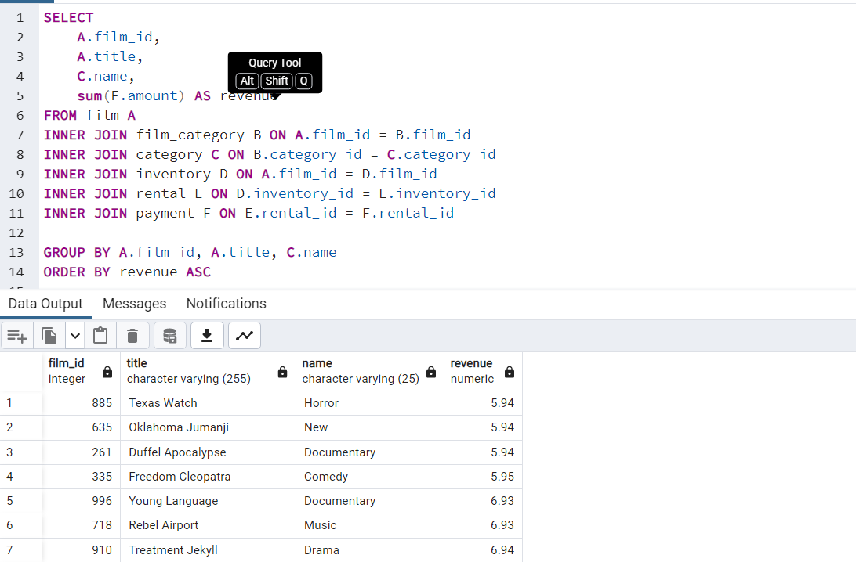
2. Rockbuster: financial overview
Understanding which are the most demanded genres and most profitable movies in the Rockbuster collection
Performing SQL query to identify most profitable movies

Slide 9
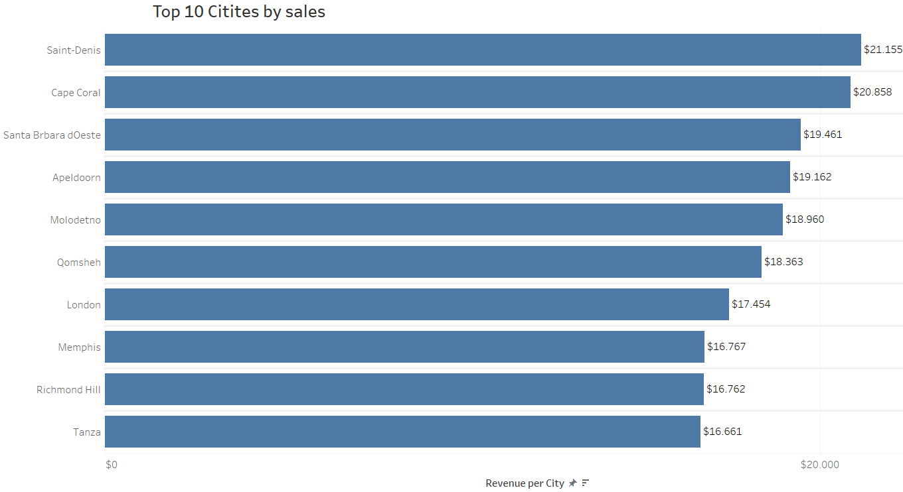
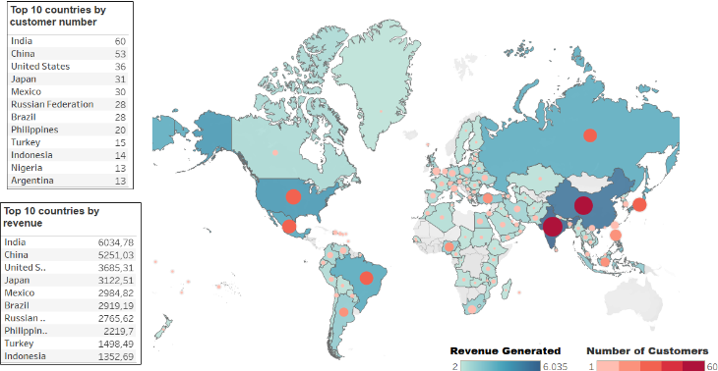
2. Rockbuster: customer overview
Understanding which are the most demanded genres and most profitable movies in the Rockbuster collection
Identifying the 10 cities that generate the highest revenue

Slide 10
2. Key recommendations for Rockbuster
Increase the video library across all genres, Thrillers included. All genres performed equally well, relative to the numbers of titles of Rockbuster stores.
Increase the video library across all ratings. Considered the number of titles and their ratings in the store, all ratings performed relatively equal.
Advertising for new streaming service in India, China, United States, Japan, and Mexico! In these countries are the most customers which provide the highest revenues..

Slide 11

3. Preparing for Influenza Season
Instacart is an American online grocery shop that operates inn the US and Canda!
Objectives | Data | Tools and Skills
To help a medical staffing agency that provides temporary workers to clinics and hospitals on an as-needed basis. The final results examine trends in influenza and how they can be used to proactively plan for staffing needs across the country. | Influenza deaths in the US for period 200-2017 down by state, age group and gender. Data Us census data showing the population of each US state for the period 2009 . 2017 by age, group, and gender. Data | Designing a data research project Data cleaning, profiling, integrity and transformation Statisticah hypothesis testing Forecasting & Storytelling with Tableau

Slide 12
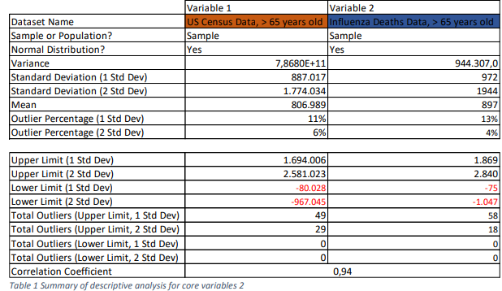

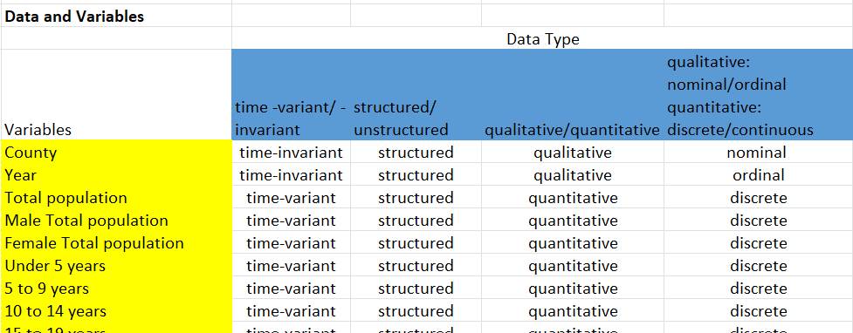
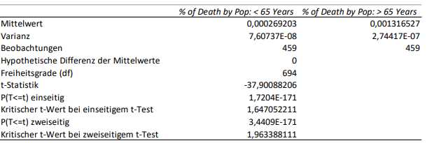
2. Data profiling and statistical analysis
1.
3.
4.
2.
Statistical analyse of different variables (e.g. SD, Variance, Mean etc.)
Evaluation of the correlation between 2 Variables.
Exploration of different statistical values of relevant Variables.
Exploration of different Data Types.

Slide 13
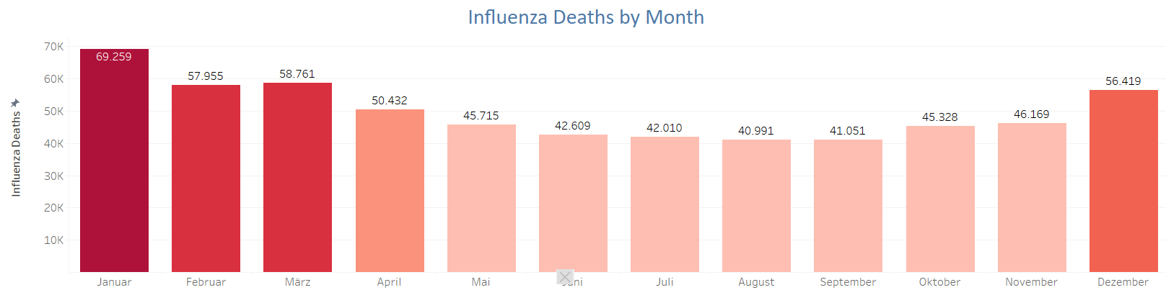
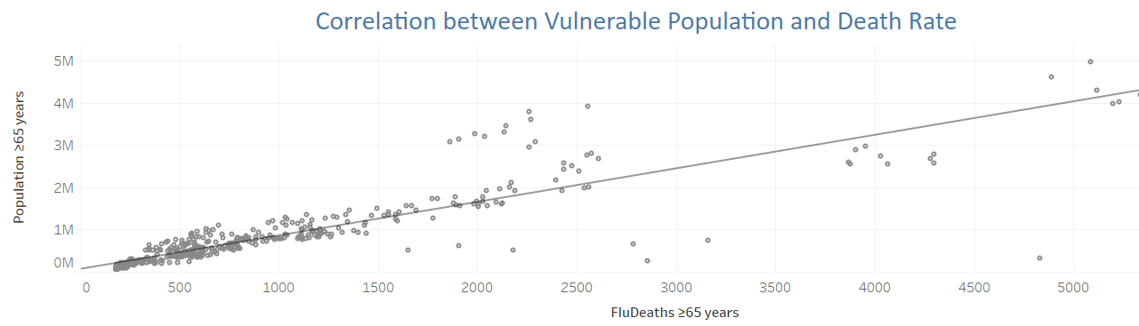
3. When is influenza season and who is risk population?
Influenza cases peak during the winter months (December to March) . Summer months display the least influenza deaths.
Most deaths caused by influenza are among population above 65 years, which account fof 67% of the total fatalities. There is strong positive correlation between deaths from influenza and the number of elderly population

Slide 14
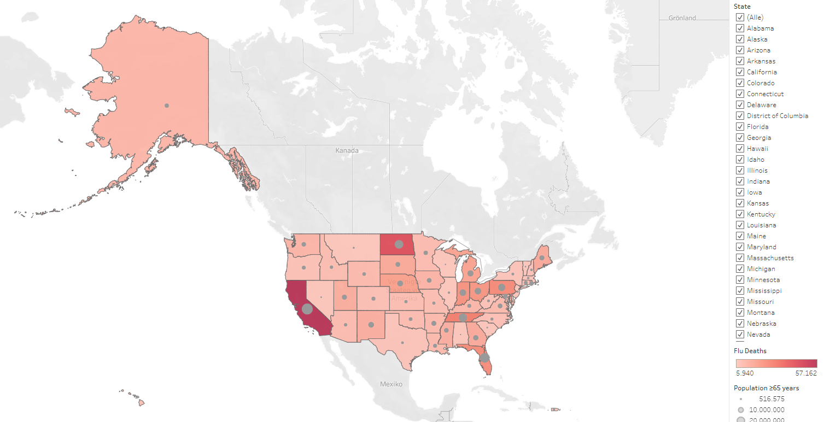
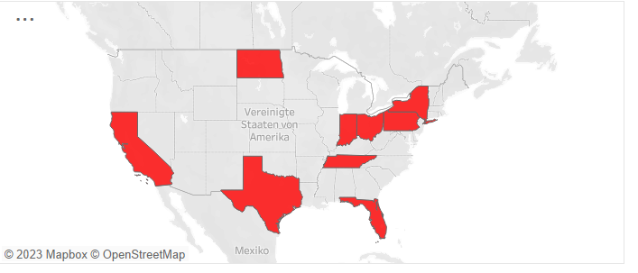
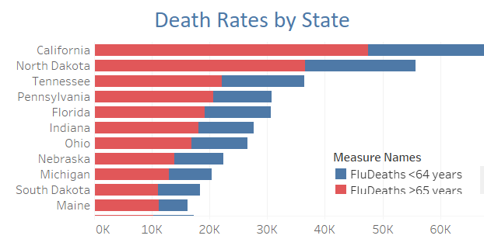
3. Where does influenza hit the hardest?
The most threatened states are California, North Dakota, Tennessee….

Slide 15
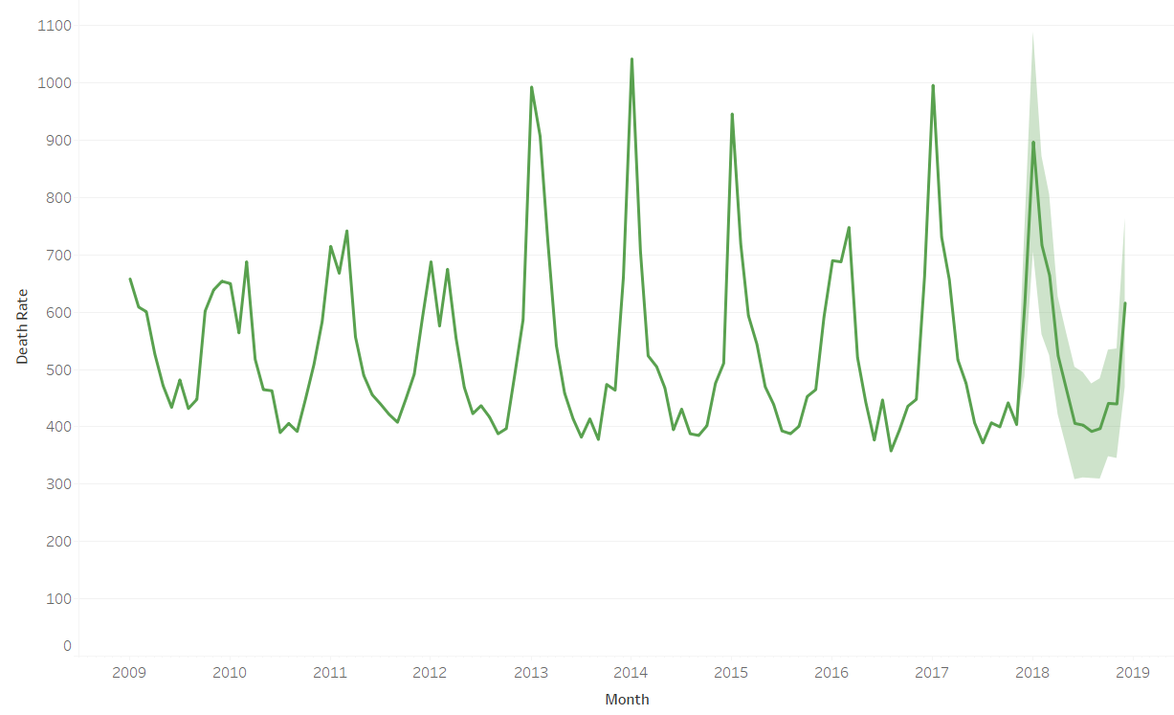
2. Key recommendations for Rockbuster
The staffing agency needs to be ready for the influenza season peak in the winter months, from December to March
Influenza mortality rate is affected primarily by two factors: Age group and climate
Population above 65 years should considered a risk group, as they are significantly more affected by Influenza than younger population. Staffing of areas with high concentration of elderly population should be prioritized
Influenza affects differently the distinct US regions. The southwestern states are clearly less affected by it, whereas the Midwest and, especially the Southeast are hit much harder. Consequently, medical staff can be transferred from less affected southern States to those more in need in the north.

Slide 16
4. GameCo.
GameCo is a videogame company looking for new market insights
Objectives | Data | Tools and Skills
Use historic data on videogame sales to perform a descriptive analysis to help GameCo understand how their new games might fare in the market. | Open publice source from kaggle here. | Designing a data research project Data cleaning, profiling, integrity and transformation Exploratory data analysis, data wrangling and subletting and data visualization in Python Excel with a final report in Tableau.

Slide 17
5. Impact of Covid-19 to Layoff Rates
Objectives | Data | Tools and Skills
This Project aims to analyze the layoffs data from various companies and industries. The data includes information such as company name, industry, number of layoffs, and reason for layoffs. | Influenza deaths in the US for period 200-2017 down by state, age group and gender. Data Us census data showing the population of each US state for the period 2009 . 2017 by age, group, and gender. Data | Designing a data research project Data cleaning, profiling, integrity and transformation Statisticah hypothesis testing Forecasting & Storytelling with Tableau
The dataset is meant to analyze mass layoffs in context of the Covid 19 Panemdic from various companies and industries.

